Slide 1
SKILLS AND TALENTS MANAGEMENT SYSTEM
Maryam Ahmed
Nabeel Khan
Tooba Bibi
Course: Data Base management System

Slide 2



Our Team
TOOBA
BIBI
MARYAM
AHMED
NABEEL
KHAN

Slide 3
INTRODUCTION
Our project, Skills and Talents Management System is a database that includes data about the students at university of every department. This database will help us to keep a track of all the students and the skills related to them in an organized manner

Slide 4
INTRODUCTION
Data about students such as name, contact, depart etc. is managed by every educational sector. But when it comes to skills of an individual universities are usually not familiar with the different type of talents that a student can’t have. This leads to ignorance of the hidden talents of the students
PROBLEM STATEMENT
To overcome this problem, we have gathered the data of skills of students of different departments. With their basic information such as SHUID, name, contact, address etc we have introduced a skill ID as well that uniquely identifies the skill of each student.
PROPOSED SOLUTION

Slide 5
NORMALISATION
First Normal Form

Slide 6
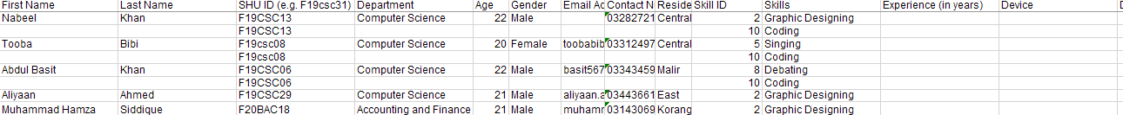
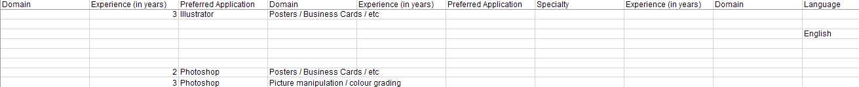
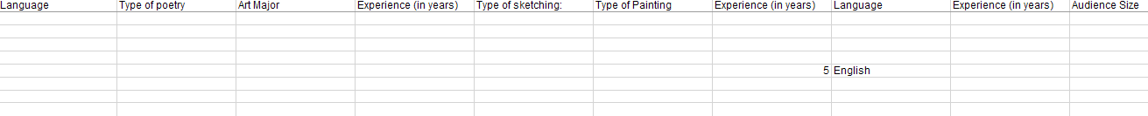
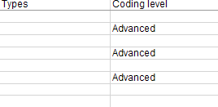

Slide 7
NORMALISATION
Second Normal Form
Composite key: SHU ID + Skill ID

Slide 8
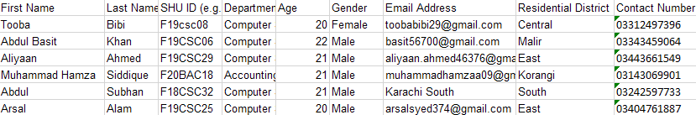
1. Students Information Table:
Dependency: SHU ID -> First Name, Last Name, Department, Age, Gender, Email Address, Residential District, Contact Number

Slide 9
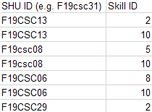
2. Students Skills Table
SHU ID, Skill ID (Composite key)

Slide 10
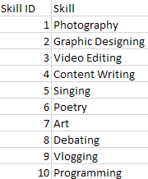
3. Skills Table
Skill ID -> Skill

Slide 11
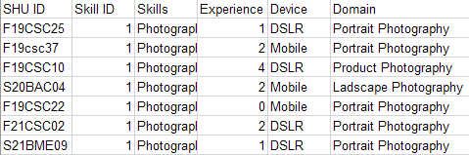
4. Photography Table
SHU ID -> Skill ID, Skills, Experience (in years), Device, Domain

Slide 12
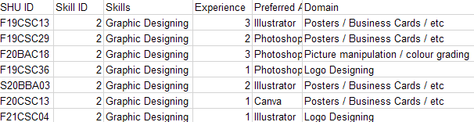
5. Graphic Designing Table
SHU ID -> Skill ID, Skills, Experience (in years), Preferred App, Domain

Slide 13
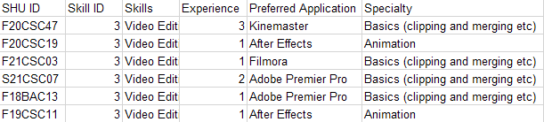
6. Video Editing Table
SHU ID -> Skill ID, Skills, Experience (in years), Preferred App, specialty

Slide 14
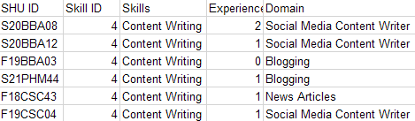
7. Content Writing Table
SHU ID -> Skill ID, Skills, Experience (in years), Domain

Slide 15
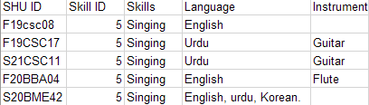
8. Singing Table
SHU ID -> Skill ID, Skills, Language, Instrument

Slide 16
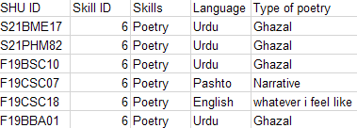
9. Poetry Table
SHU ID -> Skill ID, Skills, Language, Type

Slide 17
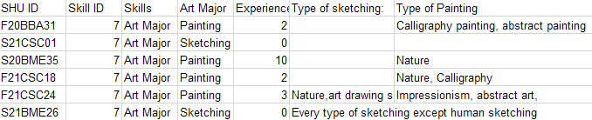
10. Art Table
SHU ID -> Skill ID, Skills, Art Major, Experience, Sketching type, Painting type

Slide 18
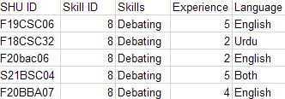
11. Debating Table
SHU ID -> Skill ID, Skills, Experience, Language

Slide 19
12. Vlogging Table
SHU ID -> Skill ID, Skills, Experience (in years), Audience, Type

Slide 20
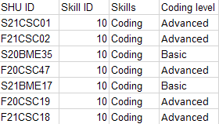
13. Programming Table
SHU ID -> Skill ID, Skills, Coding level

Slide 21
7 STEPS TO DESIGN A DATABASE
STEP 4:
Turn information into columns:
STEP 1:
Determining the purpose
STEP 2:
Find and organize the information required:
STEP 3:
Divide the information into table
StudentsInfo(Fname, Lname, SHU_ID, Department, Age, Gender, Contact, Residential_Address, Email_Address)
StudentSkill(SHU_ID,Skill_ID)
Skills(Skill_ID, Skills)
Photography(SHU ID,Skill ID,Skills,Experience,Device,Domain)
GraphicDesigning(SHU ID,Skill ID,Skills,Experience,Preferred,Application,Domain)
VideoEditing(SHU ID,Skill ID,Skills,Experience,PreferredApplication,Specialty)
ContentWriting(SHU ID,Skill ID,Skills,Experience,Domain)
Singing(SHU ID,Skill ID,Skills,Language,Can you play an instrument? If yes:)
Planning this database would help me to organize skills of students in the university
I would need information about the Student Name, SHU_ID, skills or talents, contact, address, gender
.
DECIDE YOUR SUBJECTS:
Skills
Students

Slide 22
7 STEPS TO DESIGN A DATABASE
STEP 4:
Turn information into columns:
STEP 5:
Set the Primary keys:
StudentInfo -> SHU_ID
Skills -> Skill_ID
StudentSkill -> SHU_ID + Skill_ID
Photography -> SHU_ID
GraphicDesigning -> SHU_ID
VideoEditing -> SHU_ID
ContentWriting-> SHU_ID
Singing -> SHU_ID
Poetry -> SHU_ID
Art -> SHU_ID
Debating -> SHU_ID
Vlogging -> SHU_ID
Coding -> SHU_ID
Poetry(SHU ID,Skill ID,Skills,Language,Type of poetry)
Art(SHU ID,Skill ID,Skills,Art Major,Experience,Type of sketching,Type of Painting)
Debating(SHU ID,Skill ID,Skills,Experience,Language)
Vlogging(SHU ID, Skill ID,Skills,Experience,Audience Size,Types)
Coding(SHU ID,Skill ID,Skills,Coding level)

Slide 23
7 STEPS TO DESIGN A DATABASE
STEP 6:
Setup the table relationships:
StudentInfo----Art
one to one
StudentInfo----Debating
one to one
StudentInfo----Vlogging
one to one
StudentInfo----Coding
one to one
StudentInfo----StudentSkills
one to many
Skills------StudentSkills
one to many
StudentInfo----Photography
one to one
StudentInfo----GraphicDesigning
one to one
StudentInfo----VideoEditing
one to one
StudentInfo----ContentWriting
one to one
StudentInfo----Singing
one to one
StudentInfo----Poetry
one to one
STEP 7:
Entity Relationship Diagram

Slide 24
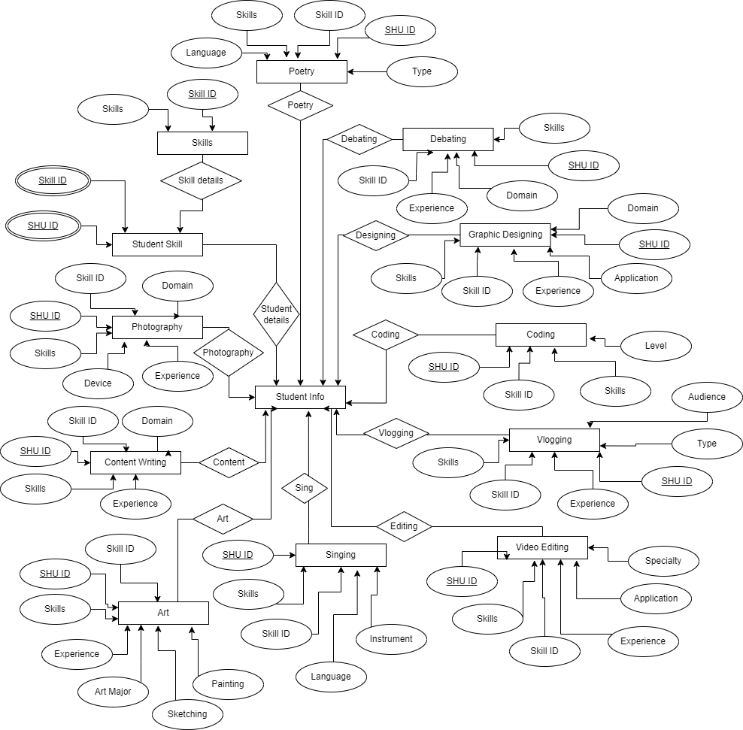
ER DIAGRAM

